Slide 1
Projektstyring pt I
Udvikling af interaktive digitale systemer

Slide 2
Dagens Program
Porteføljer – Langt om længe!!
Lidt generelt feedback
Crashcourse i projektstyring
Gruppeopgaver
Status på jeres projekter

Slide 3

¨

Slide 4
Porteføljer
Generelt rigtig fine
Meeen:
Husk citeringer!
Stadig nogle der kunne luge mere ud i jeg/vi/man etc
Begreber i kursiv
Husk ikke at ”stikke af” fra opgaven
Tal med bogstaver / tal
Selv om Verplank var primær, så var der meget guf i de andre tekster også…

Slide 5


Slide 6
Projektplanlægning
Fremadrettet – og lidt retroaktivt:
Grundlaget for jeres projekt?
Et overordnet scope?
Work Breakdown Structure (husk jeres ”problemer” fra sidst)
Kommunikationsplan for projektet?
Activity-on-Node diagram (den simple version)

Slide 7
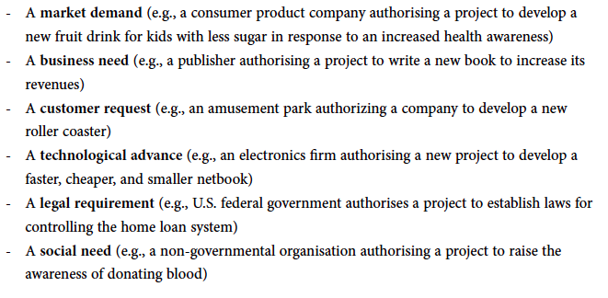
Problemer og nye muligheder

Slide 8
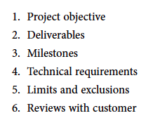
Project Scope

Slide 9
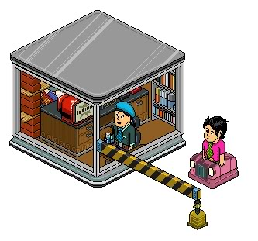
Tollgates – en form for milepæle

Slide 10
Tollgates
Tollgate |  | Decisions | Documents
TG1 | Initiate Project | Define objective and goal Timeframe for prestudy Assign Project manager | Project Charter Guidelines for pre-study
TG2 | Start Planning | Approve pre-study Execution priortization Timeframe+Budget for planning | Guideline – planning Requirement spec
TG3 | Start Execution | Approve the project plan Approve the budget Staff Project group | Project Plan Project Budget
TG4 | Follow up | Continue according to plan Decide on and implement changes | Progress report Earned value analysis
TG5 | Handover | Approve delivery | (Requirement spec) Delivery acceptance
TG6 | Close Project | Approve actual costs Terminate the project group Terminate the project | Final Report
TG7 | Evaluate buiness impact | Approve the project | Buisness case Project Charter Final Report

Slide 11
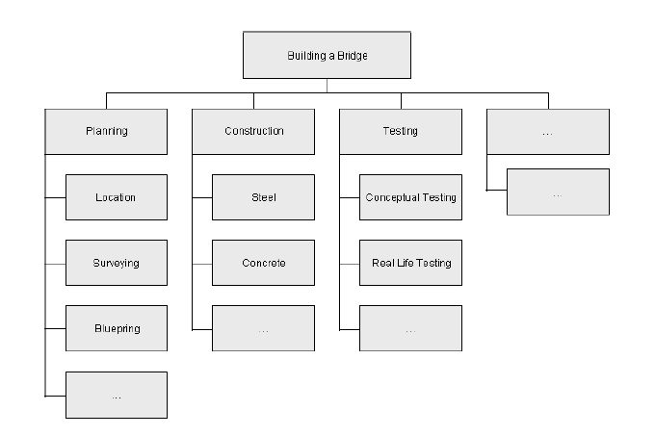
WBS – Work Breakdown Structure

Slide 12
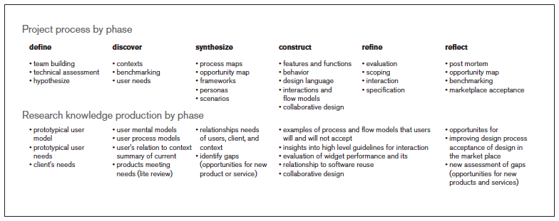

Slide 13
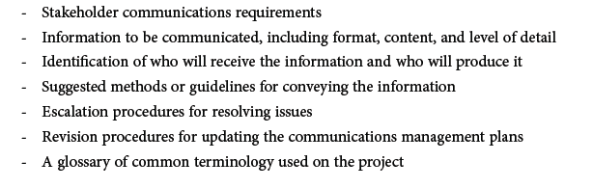
Project Communication Plan

Slide 14
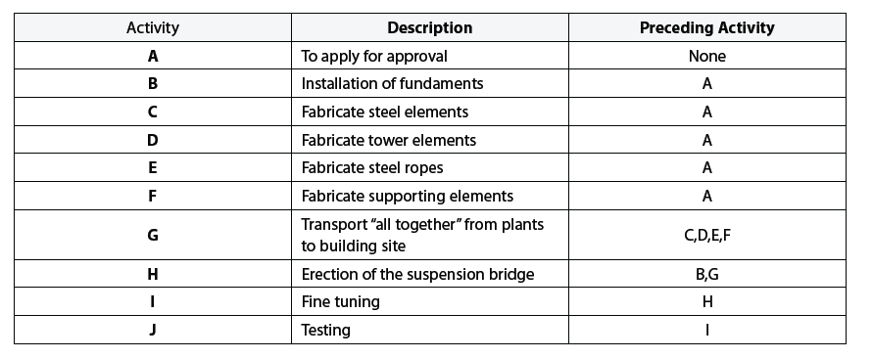
Activity-on-Node Network

Slide 15
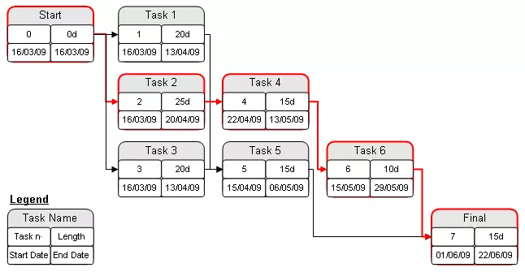
Forsimplet AON-diagram

